Slide 1
POWERPOINT
Introduction About Ribbon
File
Home
Insert
Draw
Transitions
Animation
Slide show
Record
Review
View
Help

Slide 2
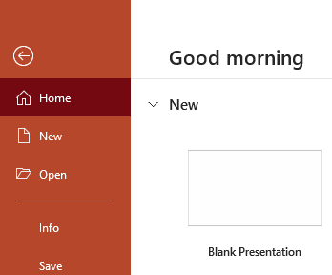
1. FILE
At one end of the ribbon is the file tab, which you use for the behind-the-screen stuff you do with a file, such as opening, saving, sharing, exporting, printing and managing your presentation. Click the file tab to open a new view called the Backstage, to return to the presentation that you were working on.
1.1 New
Click the File tab to open a new view called the Backstage.
1.2 Open
that’s used for open a save file.

Slide 3


1.3 Info
All information that you need about your currently active presentation is available in a single easily accessible location. This location is the Info tab of Backstage View. Using the options available within this tab, you can access information about permissions set for the active presentation, prepare your content for sharing, and also possibly recover older versions of unsaved files. In addition, the Info tab also provides access to many more properties that we will discuss on this page.
A
Upload: This option is only available for local files. If you see no Upload button, you may have opened a file from your OneDrive account.
Share: Once we sign in to OneDrive (or multiple OneDrive accounts), you will see a slightly different Share dialog box

Slide 4
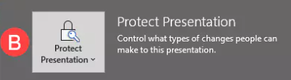
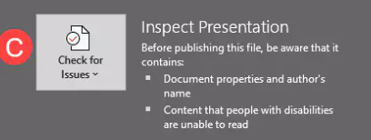
B
Protect Presentation: Brings up a flyout menu that provides several options to protect your presentation, as shown in image. Essentially, you can control the types of changes users can make to this presentation.
C
If you are planning to share your presentation with others, you should inspect your presentation for confidential information, validate its accessibility, and check for compatibility with previous versions. You can also do a spell check, and examine the presentation for hidden data and personal information stored in comments, notes, or document properties.

Slide 5
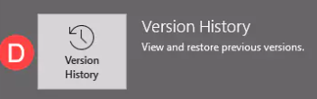
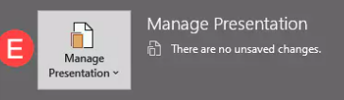
D
Version History:
If you are not signed into your Microsoft account and open a local file, and not something that is from a OneDrive location, then clicking the Version History button will bring up the Turn on Version History? dialog box, as shown in image.
E
Manage Presentation:
In this section see image, you are provided with options to recover your unsaved presentations. This can be so helpful if you inadvertently closed your file without saving it, or if your computer or application crashed.

Slide 6

1.4 Save
Save, pick or browse to a folder, type a name for your presentation in the File name box, and click Save. Save your work as you go. Hit Ctrl+S often.
1.5 Save As
When you save your files to the cloud, you can share and collaborate with others, and get to your files from anywhere - on your computer, tablet, or phone.
1.5 Export
That’s use fore exporting your file to pdf & video.
1.6 Close
That’s use for close your ppt window.

Slide 7

1.7 Account
That’s show your one drive current login id’s.
1.8 Feedback
If you are facing some issue then you can report this.
1.9 Options
That’s show many type of Power Point option like a general, advance, language.

Slide 8
2. Home
That’s have many type tools. Which use into the project who’s given by your teachers for example paste, new slid, layout, reset, section, language type, font size etc.
New Slide
That’s use for insert a new slide.
Layout
That’s use for insert a new slid but different type like a pic, heading & sub heading.

Slide 9

Reset
That’s use to reset your working page.
Section
That’s use to divided you ppt by sections.
Language
That’s have many type of languages.
Font size
That’s use to manage your font size.
Home tab also have many type of feature like a bold, colored, text direction, shape etc.

Slide 10

3. Insert
That’s have many type of tools like table, Image, picture, screen shot, photo album, IIIsutrations Shapes , Icons , 3D Models, SmartArt ,Chart
Links , Zoom , Link, Action Text, Text box , Header & Footer , WordArt, Date & time , Slide number
4. Draw
That’s use for draw something on your ppt.

Slide 11

5. Design
There have many type of themes and variants & you can format background also
6. Transitions
There have a animations which is use for slides

Slide 12


7. Animations
That’s very enjoyable part into the ppt. if you are make a video on ppt that’s have many type of
Animations.
8. Slide show
That’s have many type of tools like a beginning, from record etc.

